Slide 1
Physical Chemistry
Ying Hu
(Fifth edition)
Bilingual Program
All rights reserve:The 华 east science and engineering university the physical chemistry teach to grind room

Slide 2
Part V Extension
Chapter 15
Interfacial Phenomena
Bilingual Program
All rights reserve:The 华 east science and engineering university the physical chemistry teach to grind room

Slide 3
Framework of the Chapter
  15.1 Introduction
  15.2 Interfacial Tension and Interfacial Excess
  I. Thermodynamics of Interfaces
  15.3 Fundamental Equations and Equilibrium Conditions
  15.4 Laplace Equation
  15.5 Kelvin Equation
  15.6 Gibbs Isotherm
  15.7 Wetting
  II. Characteristic Properties of Interfacial Equilibria
  15.8 Vapor-Liquid Interface and Liquid-Liquid Interface
  15.9 Surfactants and Surface Films
  15.10 Adsorptions on Solid Surface
  15.11 Semi-Empirical and Theoretical Methods for Gas-Solid Adsorptions
  III. Rate Processes in Interfaces
  15.12 Dynamic Interfacial Tension
  15.13 Chemical Reactions in Surface Membranes
  15.14 Heterogeneous Catalysis
  15.15 Heterogeneous Catalytic Kinetics

Slide 4
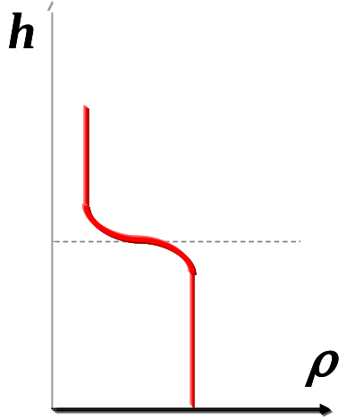

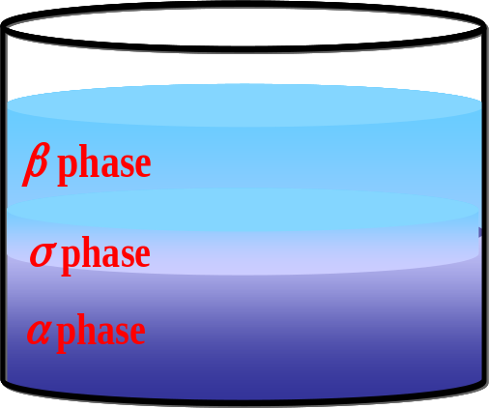

15.1 Introduction
Extensive properties
General phase equilibrium
Real phase equilibrium
The intensive properties undergo a sudden change, the values are the sum total of the corresponding properties of the two phases
The intensive properties undergo a continuous change, the values are the sum total of the corresponding properties of the two phases and interface phase.
β
β
phase
phase
α
α
phase
phase

Slide 5
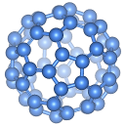
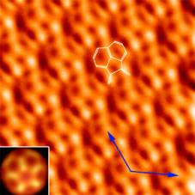

15.1 Introduction
Interfacial Phenomena
All the physical and chemical phenomena concerning interfaces.
Macroscopically
Microscopically
Equiluibria
Rates
structure
Relations between σ, Γ_{i} of the interfacial phase and T, p, x_{i} (b_{i}, c_{i}) of the bulk phase
Changes of σ _{i}, Γ_{i} with time when the interfacial phase deviates from equilibrium.
Experimental methods
XRD, STM, AFM, SEM, TEM…
The structure, shape and state of molecules in the interfacial layer
Theoretical methods
Quantum mechanics
The surface chemical bonding
Statistical mechanics
The distribution of molecules

Slide 6
15.1 Introduction
General principles
Thermodynamics of interfaces
Equiluibria
Characteristic properties
Relations among σ, A_{s}, T and Γ_{i}
Interface
transport phenomena chemical reactions
General principles
Interfacial kinetics, Adsorption kinetics
Rates
Interfacial viscosity,
Diffusion coefficient,
Reaction rate coefficient,
Activation energy, ...
Characteristic properties

Slide 7
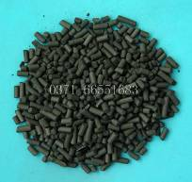
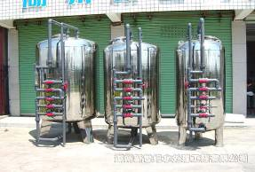

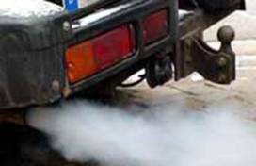
15.1 Introduction
Applications of Interfacial Phenomena
Adsorption
Heterogeneous catalysis

Slide 8

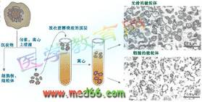



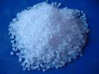
15.1 Introduction
Surface films, such as bi-layers, vesicles, LB films
COVID-19
Creation of new phases

Slide 9

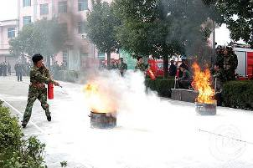


15.1 Introduction
Foams and Emulsions.
Friction and Lubrication.

Slide 10



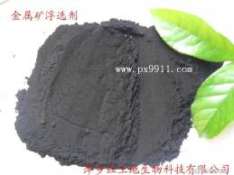
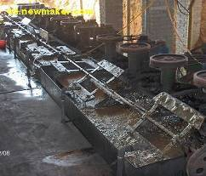
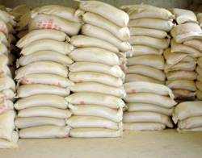
15.1 Introduction
Detergency
Ore Dressing

Slide 11
Framework of the Chapter
  15.1 Introduction
  15.2 Interfacial Tension and Interfacial Excess
  I. Thermodynamics of Interfaces
  15.3 Fundamental Equations and Equilibrium Conditions
  15.4 Laplace Equation
  15.5 Kelvin Equation
  15.6 Gibbs Isotherm
  15.7 Wetting
  II. Characteristic Properties of Interfacial Equilibria
  15.8 Vapor-Liquid Interface and Liquid-Liquid Interface
  15.9 Surfactants and Surface Films
  15.10 Adsorptions on Solid Surface
  15.11 Semi-Empirical and Theoretical Methods for Gas-Solid Adsorptions
  III. Rate Processes in Interfaces
  15.12 Dynamic Interfacial Tension
  15.13 Chemical Reactions in Surface Membranes
  15.14 Heterogeneous Catalysis
  15.15 Heterogeneous Catalytic Kinetics

Slide 12

All rights reserve:The 华 east science and engineering university the physical chemistry teach to grind room
16

Slide 13

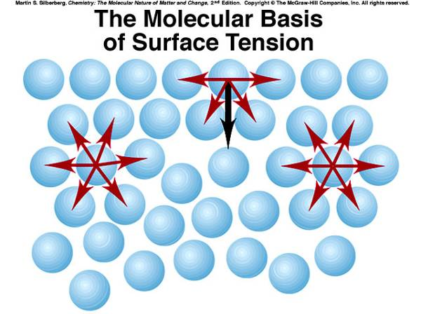
15.2 Interfacial Tension and Interfacial Excess
Why water droplets, mercury droplets and gas bubbles usually tend to be spherical?

Slide 14
15.2 Interfacial Tension and Interfacial Excess
1. Interfacial Tension
Tensions in the Interfacial Layer
Needs additional work
The molecules in the interface layer bore the unsymmetrical forces with a surplus force remained. They have a tendency to leave one bulk phase and approach the other.
Macroscopically, the interface will shrink to adopt a shape with a smallest area.

Slide 15
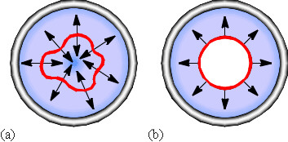
15.2 Interfacial Tension and Interfacial Excess
Interfacial Tension
An interface could be regarded as a tightly stretched elastic thin film, in which contracting tensions exist resulting in the decrease of the film area.
Interfacial tension (σ or γ) is defined as the contracted tension per unit length in the interface. It has a unit of N⋅m⁻¹ or J⋅m⁻²
1dyn ⋅ cm⁻¹=10³ N ⋅ m⁻¹
The contracted tension acts on the periphery along the tangent direction and perpendicular to the periphery. The total tension is directly proportional to the length of the periphery.
A soap liquid film in a metal ring,

Slide 16
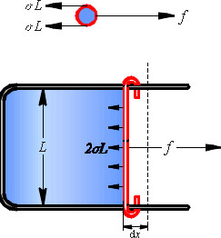
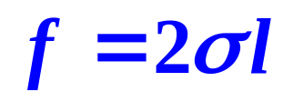

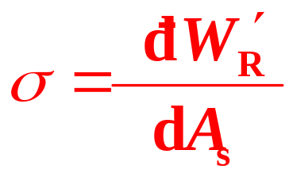
15.2 Interfacial Tension and Interfacial Excess
Interfacial Work
The total tension
?
The reversible interfacial work
The interfacial tension = the reversible interfacial work gained with the increase of a unit interfacial area.

Slide 17
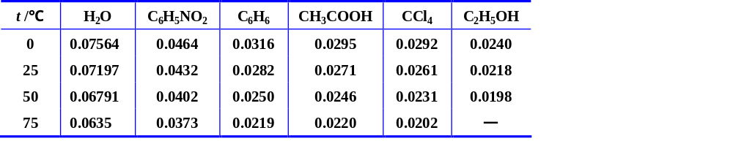
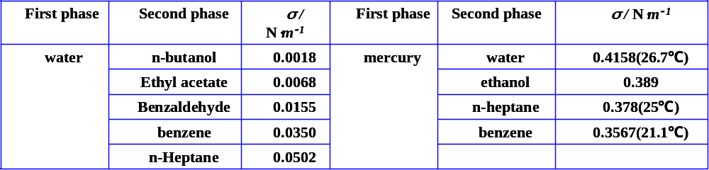
15.2 Interfacial Tension and Interfacial Excess
Surface tensions of several pure liquids, σ / N⋅m⁻¹
The Interfacial tensions at 20 ℃
The surface tension decreases with temperature
The surface tension will approach zero at the critical point.

Slide 18

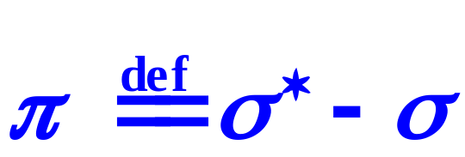
15.2 Interfacial Tension and Interfacial Excess
Spreading Pressure
Movable bar
solution
solution
pure solvent
pure solvent
solution
Usually σ* > σ, π > 0.
The spreading pressure causes the interface of the solution to spread further.

Slide 19
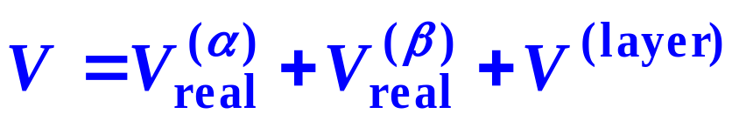
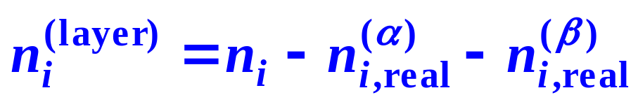
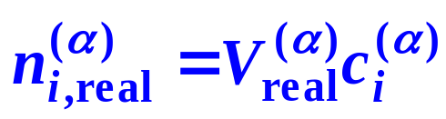
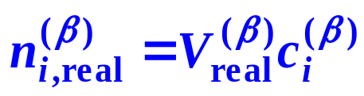
15.2 Interfacial Tension and Interfacial Excess
2. Unit Interfacial Excess
Modeling
B B’
Interfacial layer
A A’

Slide 20
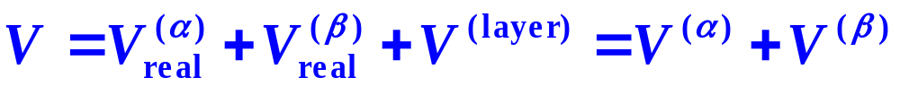
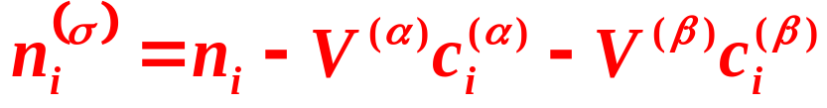
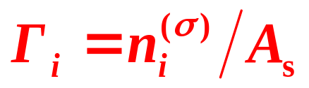
15.2 Interfacial Tension and Interfacial Excess
Gibbs Interfacial-Phase Model
Interfacial Excess and Unit Interfacial Excess
Interfacial Excess
Interface phase
σ
S S’
Unit Interfacial Excess

Slide 21
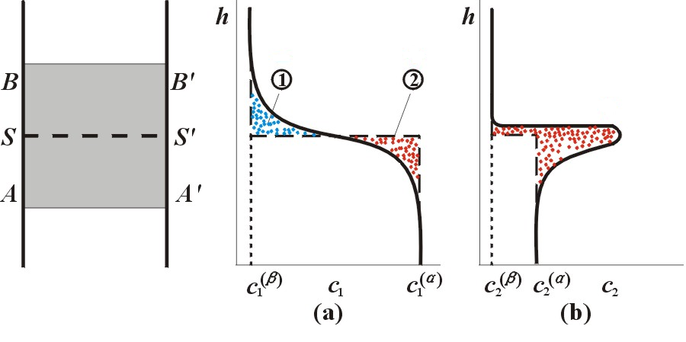


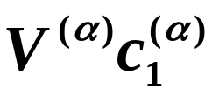
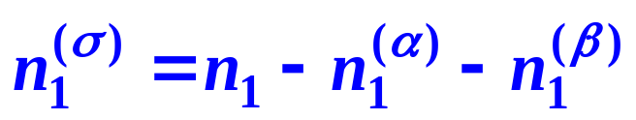
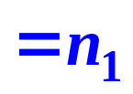
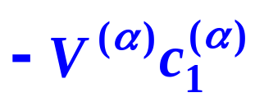
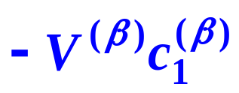
15.2 Interfacial Tension and Interfacial Excess
Physical Picture of Interfacial Excess
Real
Model
Solvent
Solute
③
= S① - S②
= S③

Slide 22
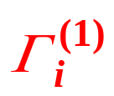
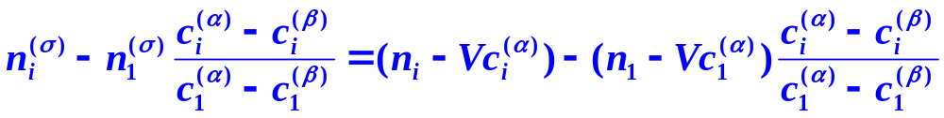
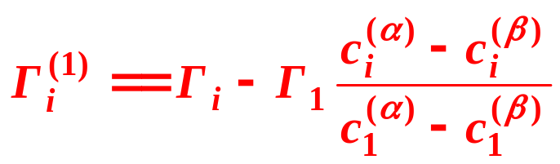
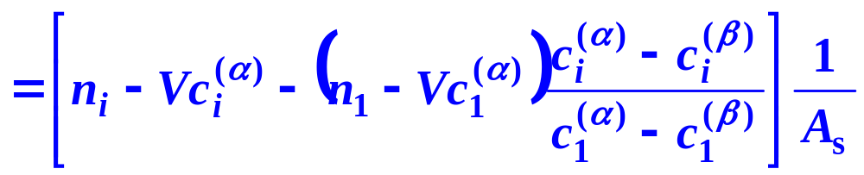
15.2 Interfacial Tension and Interfacial Excess
Gibbs Interfacial-Phase Model
(4) Gibbs Unit Interfacial Excess
The solvent 1 is adopted as a reference to define a relative unit interfacial excess for the solute i, called the Gibbs unit interfacial excess with a symbol
SS-position independent !
Definition I
def

Slide 23
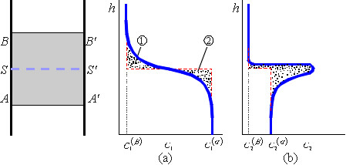

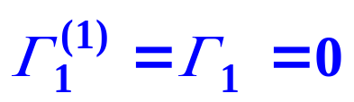
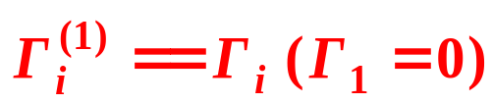
15.2 Interfacial Tension and Interfacial Excess
4. Gibbs Unit Interfacial Excess
def
Definition II
The special position of SS’ In Gibbs model makes the absolute area of ① just equals that of ② .
The interfacial excess Γ_{i} when Γ₁ of the solvent equals zero.

Slide 24
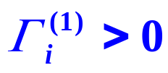
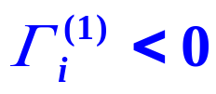
15.2 Interfacial Tension and Interfacial Excess
Adsorption
The phenomena of matters enriched or repelled in the interfacial layer.
Unit Interfacial Adsorption
Positive adsorption
solute i is enriched in the interfacial layer
Negative adsorption
solute i is repelled in the interfacial layer

Slide 25
I.
Thermodynamics of Interfaces
Bilingual Program
All rights reserve:The 华 east science and engineering university the physical chemistry teach to grind room

Slide 26
Framework of the Chapter
  I. Thermodynamics of Interfaces
  15.3 Fundamental Equations and Equilibrium Conditions
  15.4 Laplace Equation
  15.5 Kelvin Equation
  15.6 Gibbs Isotherm
  15.7 Wetting

Slide 27
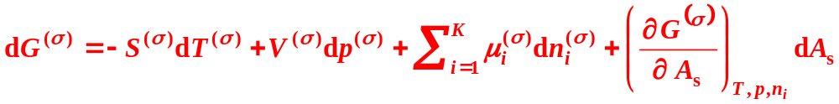


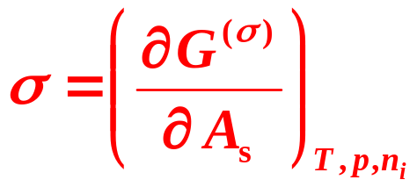
1. Fundamental Equations for systems with interfacial phases
Gibbs Function of Interfacial Phase
Besides the pressure, we have the interfacial tension in the interfacial phase,
for describing the state, the interfacial area As have to be added.
For isothermal, isobaric and unchanged composition process,
Specific interfacial Gibbs function

Slide 28
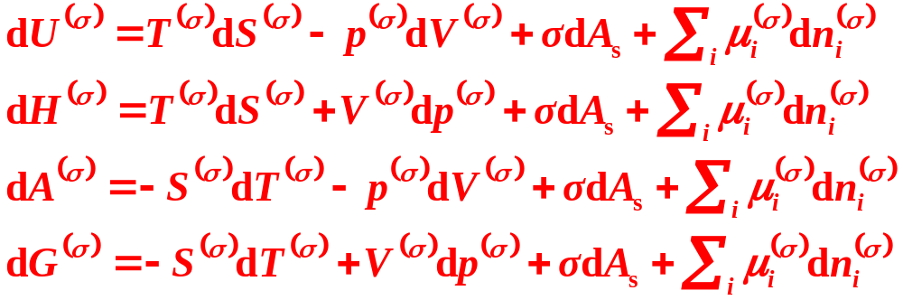

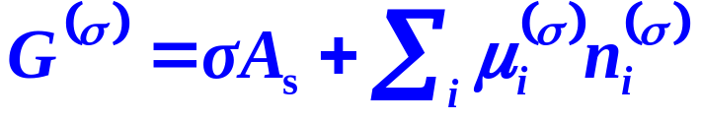
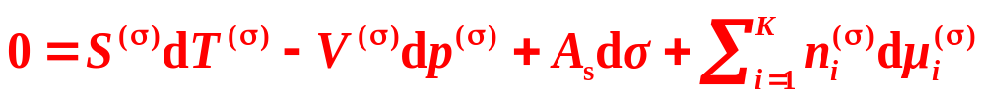
Fundamental Equations for Interfacial Phase
Gibbs-Duhem Equation for Interfacial Phase
Keeping unchanged

Slide 29

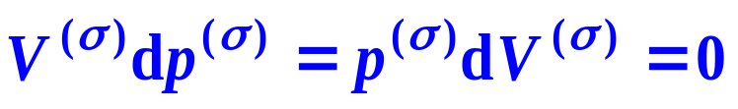
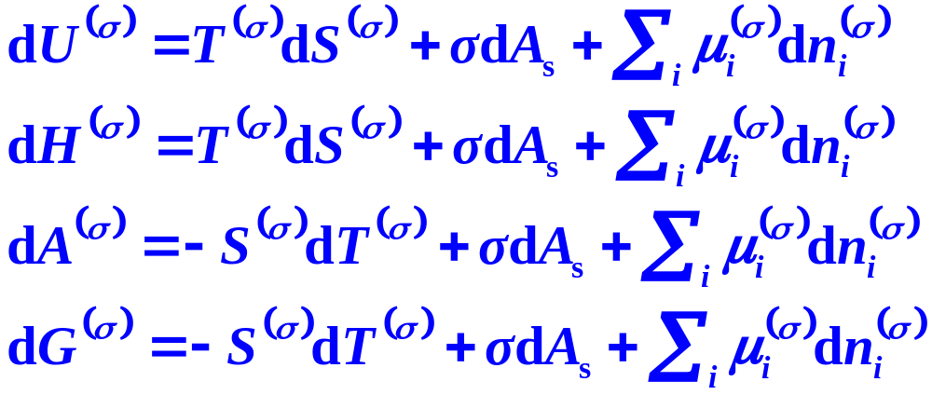


Fundamental Equations for Gibbs Interfacial Model
Interfacial excess
U(σ), the interfacial excess thermodynamic energy,
H(σ), the interfacial excess enthalpy,
A(σ), the interfacial excess Helmholtz function,
G(σ), the interfacial excess Gibbs function.

Slide 30

Interfacial Tension
Force
The contracted tension per unit length in the interface.
Work
The reversible interfacial work per unit changed interfacial area
Thermodynamic functions
It is also related to the thermodynamic functions per unit interface

Slide 31





2. Equilibrium Criterion and Equilibrium Conditions when Interfacial Phases Exist
Equilibrium Criterion
Thermal Equilibrium
Mechanical Equilibrium
(Planar interface)
Phase Equilibrium
Chemical Equilibrium

Slide 32
Framework of the Chapter
  I. Thermodynamics of Interfaces
  15.3 Fundamental Equations and Equilibrium Conditions
  15.4 Laplace Equation
  15.5 Kelvin Equation
  15.6 Gibbs Isotherm
  15.7 Wetting

Slide 33








Mechanical-Equilibrium For Curved Interfaces
At equilibrium, dT=0, dni=0
Gibbs Model
mechanical-equilibrium condition

Slide 34








Spherical Liquid Droplet (l) in Gas (g)
The pressure inside the liquid droplet is greater than that of the gas phase,
The smaller the droplet, the larger is the pressure difference.

Slide 35






For the spherical liquid droplet
For the non-spherical liquid droplet

Slide 36










Spherical Cavity (g) in Liquid (l)
The pressure inside the cavity is greater than that of the liquid phase,
The smaller the cavity, the larger is the pressure difference.

Slide 37















Slide 38
Bubble
a region in which vapour is trapped by a thin film;
Example
Calculate the difference between pressures inside and outside the bubble in air with a radius 1 cm as shown in the following figure. Given that the
surface tension is 0.040Nm⁻¹

Slide 39



Solution
Laplace equation gives that
p(l)
For the outside
p₂
·
r₁
r₂
p₁
For the inside

Slide 40





Solution
It follows that
σ
σ
p(l)
p₂
·
r₁
r₂
p₁
For a bubble

